Slide 1
APOLOGETICS
IN ONE LESSON
almost
Ai1L.net
Lesson 4
A-Paul-agetics

Slide 2
In what ways did Paul act in a gracious to the Athenians?
1

Slide 3
“used to describe people of low class who speak as though they have intelligence”
Jennifer Marie Creamer God as Creator in Acts 17:24: An Historical-Exegetical Study, page 30

Slide 4
“He was a rag-bag collector of scraps of learning.”
Bruce Winter Introducing the Athenians to God: Paul’s failed apologetic in Acts 17? Themelios volume 31, issue 1, page 39

Slide 5
Describe Paul’s argument he makes in 17:24-27. Why this is significant?
2

Slide 6
List out ways in which Paul adjusted his approach for the Athenians.
3

Slide 7
“First believe that God is living, immortal and blessed”
1 Thess. 1:9
Romans 1:23
1 Tim. 1:11
Epicurus (in a letter to Menoeceus) Lives of Eminent Philosophers, 10.123

Slide 8
“God had no need of human resources”
Philodemus On Piety, fr 38

Slide 9
Church Attendance
1972-2014 (General Social Surveys)

Slide 10
What is the argument that Paul uses against idolatry? Why would this argument be persuasive?
4

Slide 11
“God had no need of human resources”
Philodemus On Piety, fr 38

Slide 12
“I have already stated that the Athenians are far more devoted to religion than other men”
Pausanias Description of Greece

Slide 13
In what ways in which Paul showed courage?
5

Slide 14
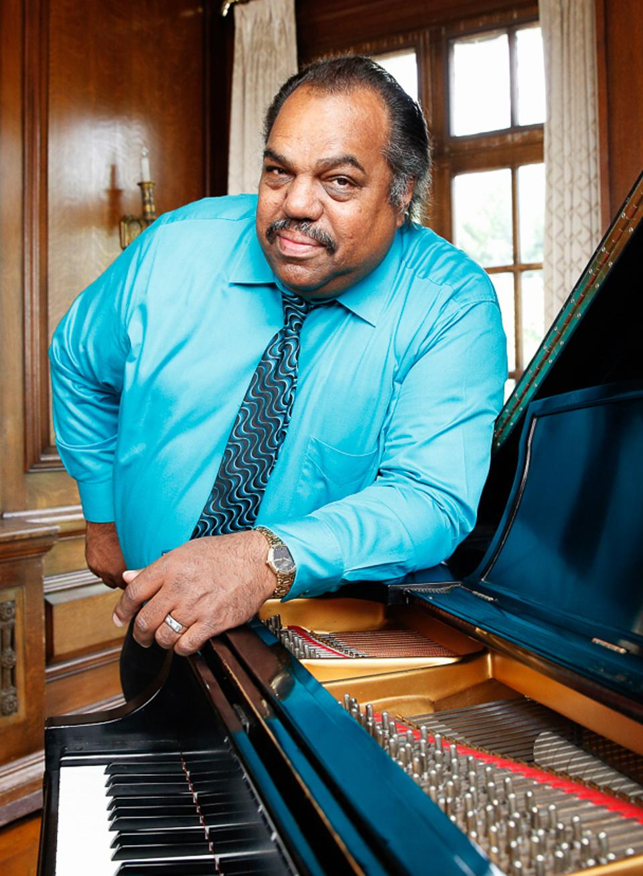
“what good is it when you complain about racism to people who already agree? You are literally preaching to the choir.”
DARYL DAVIS

Slide 15
“If the Council were so persuaded, then the god or goddess would be admitted to the Parthenon. A dedicated temple would be built to the divinity, an annual feast day endowed and included in the Athenians’ religious calendar.”
Bruce Winter Introducing the Athenians to God: Paul’s failed apologetic in Acts 17? Themelios volume 31, issue 1, page 41

Slide 16
Athenians | Paul
A special day | Mankind’s seasons are set by God (17:25)
Temple | You dwell in him (17:28)
Introducing a new God | Not a new God, and you need to be introduced to him (17:30)
They are the judge | God judges you (17:31)

Slide 17
Want can we learn from the response to Paul’s message?
6

Slide 18
“Now when they heard about the resurrection from the dead, some began to scoff , but others said, “We will hear you again about this.” So Paul left the Areopagus. But some people joined him and believed. ”
Acts 17:32-34

Slide 19
Was there anything else that stood out to you?
7

